Slide 1
Online Estimation of Geometric and Inertia Parameters for Multirotor Aerial Vehicles
권건우

Slide 2
Introduction
Motivation
Precise and robust control requires accurate knowledge of geometric and inertia parameters.
Exogenous factors cause the change of its physical parameters.
Ex) Payload transportation or manipulation
In this sense, it is essential to estimate the parameters in real time.
Previous works related “on-board sensor system”
Focus on autonomy even if it utilizes on-board sensors
Are on the basis of kinematics
Do not cover dynamic models, thus cannot get these parameters
This paper depends on motor speed measurements to estimate these parameters

Slide 3
Introduction
Previous works related to “parameter estimation”
Offline maximum likelihood approach
This approach considers different sensor uncertainties well.
But, this method runs offline. (Takes too much time to estimate on flight)
Other paper achieves online estimation through recursive least square method
However, the method relies on motion capture sensor(Measure Acceleration)
Not perfectly on-board sensor system
Contribution
Real time, on board framework to estimate the dynamic properties
When subject to changes during operation, quickly re-estimate the properties
Offer observability analysis

Slide 4
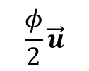
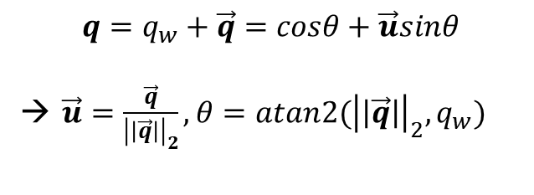


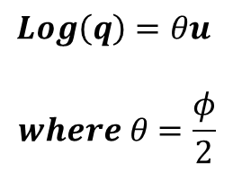
Preliminaries (v_tools.cpp에서 구현)
exp map
exp map
$$\frac{φ}{2}\vec{u}$$
$$q$$
log map
Log map
Exp map
$$Exp\left(θu\right)=q$$
$$Log\left(q\right)=θu$$
$$where θ=\frac{φ}{2}$$
$$q=q_{w}+\vec{q}=cosθ+\vec{u}sinθ$$
→ $\vec{u}=\frac{\vec{q}}{{\left|\left|\vec{q}\right|\right|}_{2}}, θ=atan2({\left|\left|\vec{q}\right|\right|}_{2},q_{w})$
$$q=cosθ+iu_{x}sinθ+iu_{y}sinθ+iu_{z}sinθ$$

Slide 5
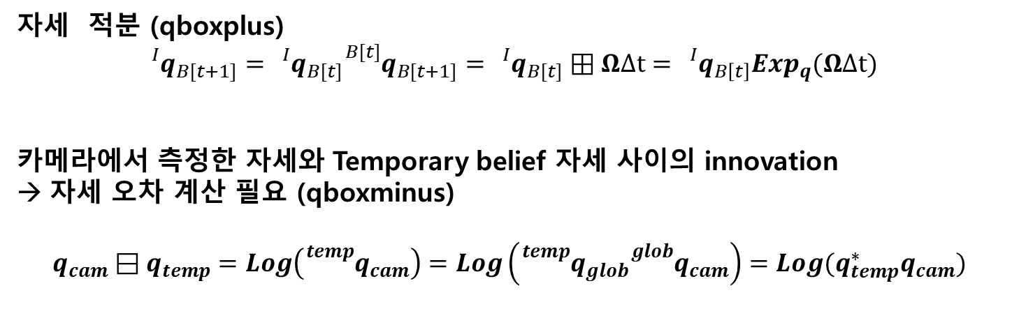
Preliminaries (geom_inertia_estimator.cpp 에서 구현)
자세 적분 (qboxplus)
$${}_{}^{I}{q_{B[t+1]}}={}_{}^{I}{q_{B[t]}}{}_{}^{B[t]}{q_{B[t+1]}}={}_{}^{I}{q_{B[t]}}⊞ΩΔt={}_{}^{I}{q_{B\left[t\right]}}Exp_{q}(ΩΔt)$$
카메라에서 측정한 자세와 Temporary belief 자세 사이의 innovation
자세 오차 계산 필요 (qboxminus)
$$q_{cam}⊟q_{temp}=Log\left({}_{}^{temp}{q_{cam}}\right)=Log\left({}_{}^{temp}{q_{glob}}{}_{}^{glob}{q_{cam}}\right)=Log(q_{temp}^{∗}q_{cam})$$

Slide 6
Method
Unlike other papers, this paper takes dynamic model into account to estimate the model parameters.
Model
Objectives
Accurately track inertia parameters even when mid-flight changes take place
Applicable to any kind of UAV
Allow the integration of measurements from different types of sensors

Slide 7
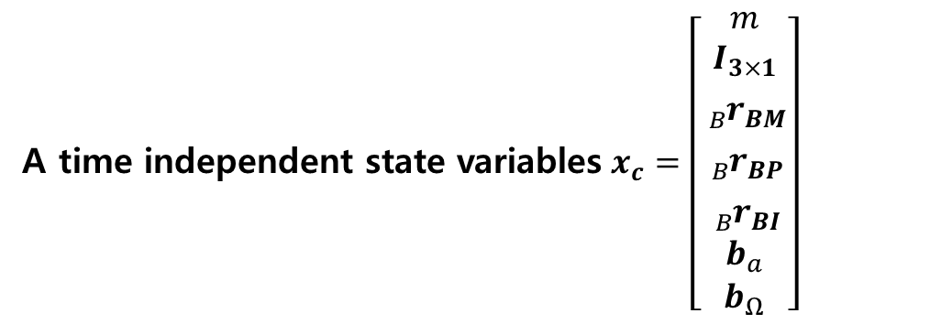
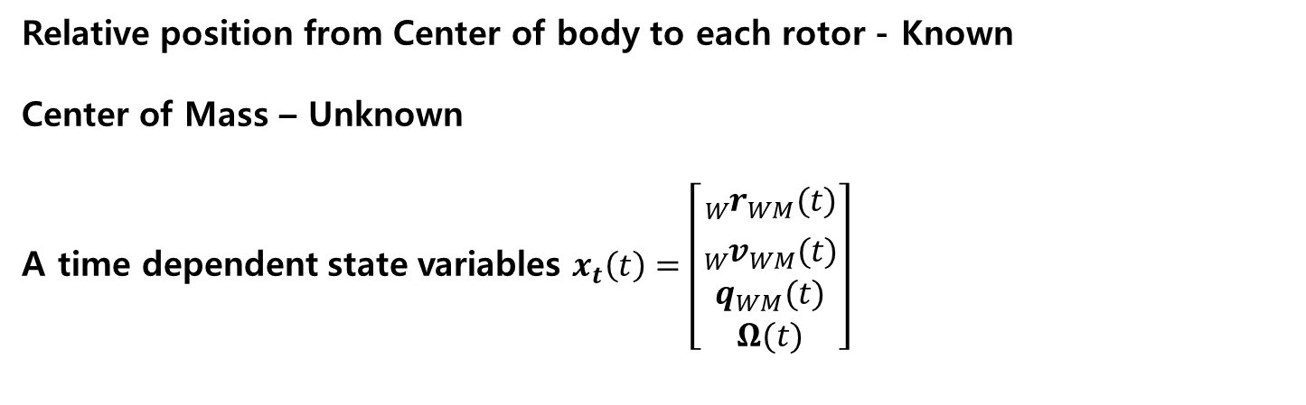

Method
Relative position from Center of body to each rotor - Known
Center of Mass – Unknown
A time dependent state variables $x_{t}\left(t\right)=\left[\begin{aligned}{}_{W}^{}{r_{WM}(t)} \\ {}_{W}^{}{v_{WM}(t)} \\ q_{WM}(t) \\ Ω(t)\end{aligned}\right]$
State variables $x(t)=\left[\begin{aligned}x_{t}(t) \\ x_{c}\end{aligned}\right]$
A time independent state variables $x_{c}=\left[\begin{aligned}m \\ I_{3×1} \\ {}_{B}^{}{r_{BM}} \\ {}_{B}^{}{r_{BP}} \\ {}_{B}^{}{r_{BI}} \\ b_{a} \\ b_{Ω}\end{aligned}\right]$

Slide 8
이 논문을 선정하게 된 결정적인 이유
※ Recursive State Estimation – Probabilistic Robotics
At the core of probabilistic robotics is the idea of estimating state from sensor data.
State estimation addresses the problem of estimating quantities from sensor data that are indirectly observerable, but that can be inferred.
Kalman Filter, Extended Kalman Filter, Unscented Kalman Filter
This is a type of recursive state estimation method.
Also, this method belongs to Bayesian filter.

Slide 9

EKF algorithm Predict Update
$EKF\left(μ_{t−1},Σ_{t−1},u_{t},z_{t}\right)$ Predict Update
$\overline{μ_{t}}=g(u_{t},μ_{t−1})$ : Process Model → 역할- 물리 법칙 인지
$G_{t}=\left[\begin{matrix}\frac{∂g_{1}}{∂x_{1}} & ⋯ & \frac{∂g_{m}}{∂x_{n}} \\ ⋮ & & ⋮ \\ \frac{∂g_{m}}{∂x_{1}} & ⋯ & \frac{∂g_{m}}{∂x_{n}}\end{matrix}\right]$
${\overline{Σ}}_{t}=G_{t}Σ_{t−1}G_{t}^{T}+R_{T}$
요점: Process Model은 물리 법칙을 인지하게끔 해준다.

Slide 10
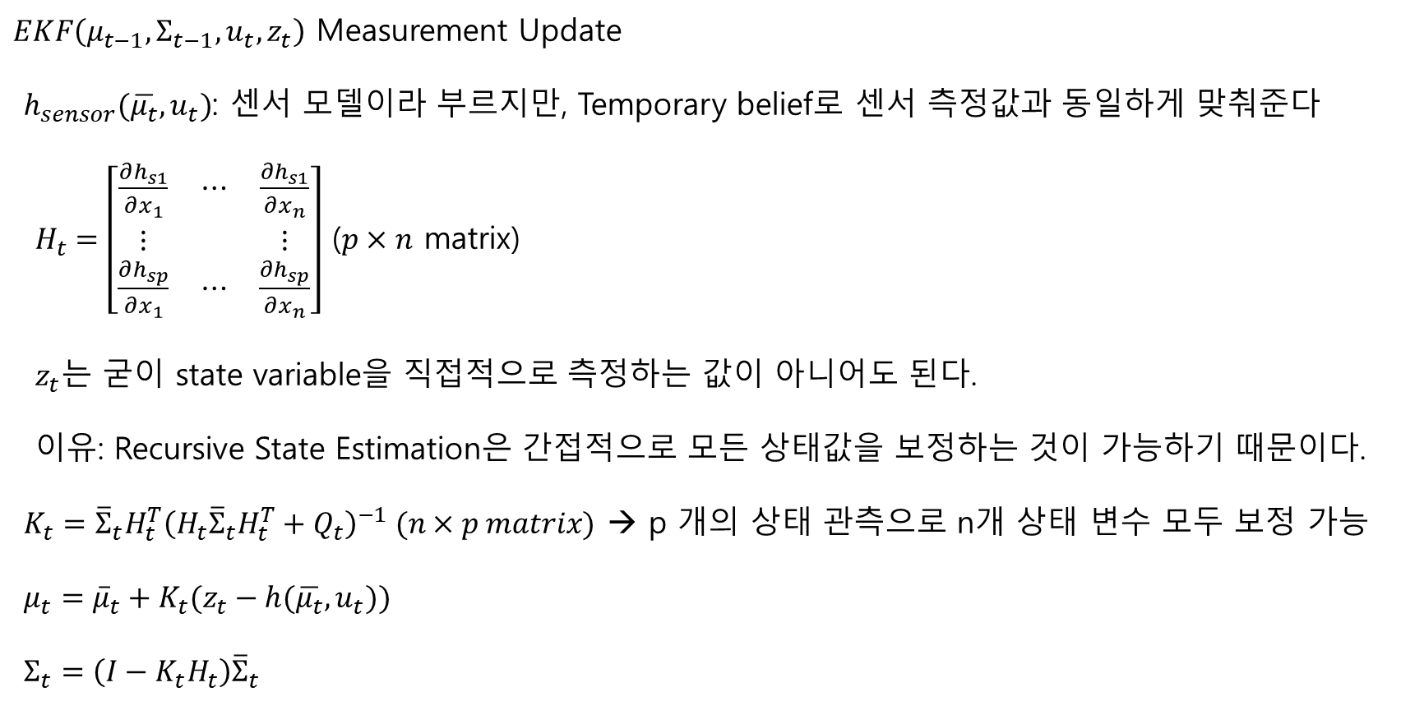
EKF algorithm Measurement Update
$EKF\left(μ_{t−1},Σ_{t−1},u_{t},z_{t}\right)$ Measurement Update
$h_{sensor}(\overline{μ_{t}},u_{t})$: 센서 모델이라 부르지만, Temporary belief로 센서 측정값과 동일하게 맞춰준다
$H_{t}=\left[\begin{matrix}\frac{∂h_{s1}}{∂x_{1}} & ⋯ & \frac{∂h_{s1}}{∂x_{n}} \\ ⋮ & & ⋮ \\ \frac{∂h_{sp}}{∂x_{1}} & ⋯ & \frac{∂h_{sp}}{∂x_{n}}\end{matrix}\right]$ ($p×n$ matrix)
$z_{t}$는 굳이 state variable을 직접적으로 측정하는 값이 아니어도 된다.
이유: Recursive State Estimation은 간접적으로 모든 상태값을 보정하는 것이 가능하기 때문이다.
$K_{t}={\overline{Σ}}_{t}H_{t}^{T}{\left(H_{t}{\overline{Σ}}_{t}H_{t}^{T}+Q_{t}\right)}^{−1} (n×p matrix)$ → p 개의 상태 관측으로 n개 상태 변수 모두 보정 가능
$μ_{t}={\overline{μ}}_{t}+K_{t}(z_{t}−h(\overline{μ_{t}},u_{t}))$
$Σ_{t}=\left(I−K_{t}H_{t}\right){\overline{Σ}}_{t}$
반환

Slide 11
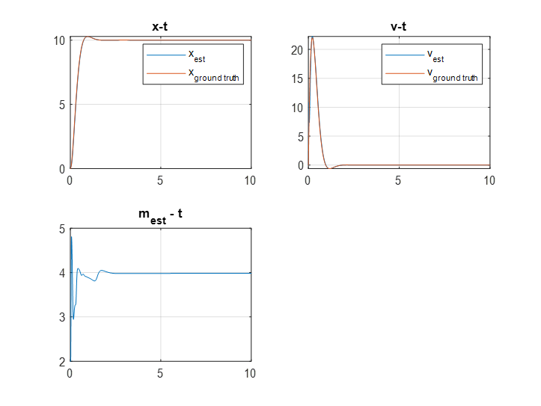
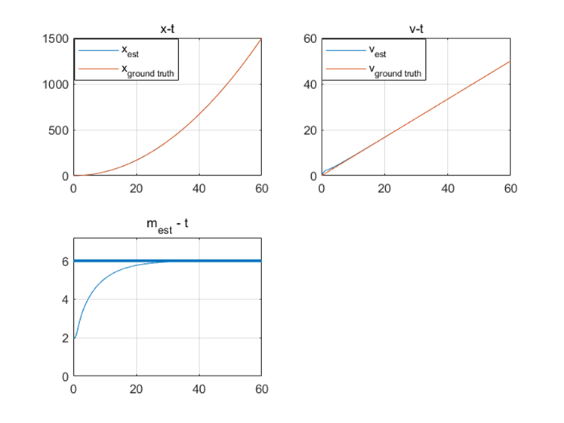
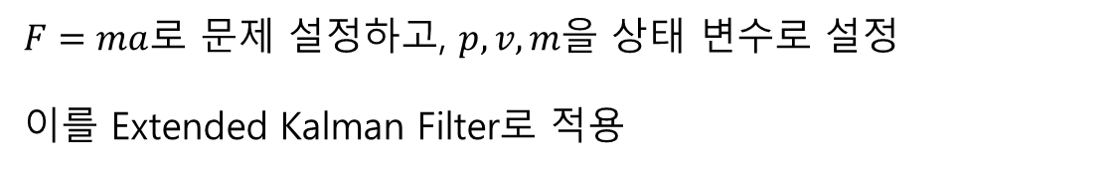
질량 추정 예제
$F=ma$로 문제 설정하고, $p, v, m$을 상태 변수로 설정
이를 Extended Kalman Filter로 적용
일정한 힘 인가 | PD 제어

